Slide 1
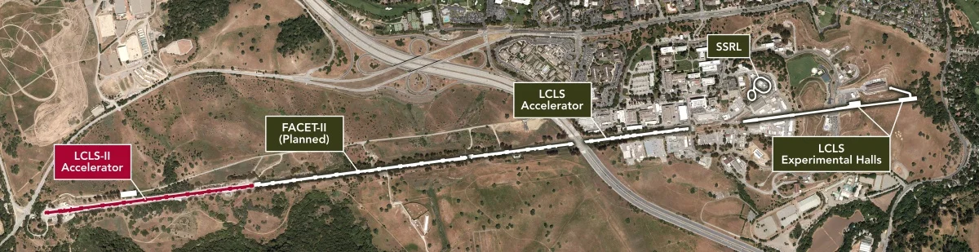
Two-Bunch Studies Internship
Rafael Sifuentes
SLAC National Laboratory
November 2022

Slide 2

Overview
Gaining familiarity with software, materials, processes, etc.
Used LCLS archive
Used simple regression Gaussian process
Issues
Lack of familiarity
Existing system issues
Auxiliary problems

Slide 3
Details
Variety of software and sites
SLAC email, calendar
Unix
SSH, keys, SDF
Terminals
Command Prompt
Anaconda
Directories
Packages
Executables
Environments
Pycharm

Slide 4
Details
Github
JupyterLab through SDF vs local Jupyter Notebook
LCLS-Archive
Simple regression Gaussian process tutorials and example notebooks
Research papers
Three primary tasks

Slide 5
Details
LCLS-Archive template
Range of dates and times
Folder of yaml files
List of PV names
Plotting settings for quads, MKBs, and TDLYs, for GDET info over time or iteration, plus histograms
Documents for important information for each yaml
Keys
Quads adjusted?
MKBs adjusted?
GDET PV present?
VOCs
Simple regression Gaussian process
Optimizing quads, MKBs, and TDLYs for obj_sum
Comparing predicted vs actual obj sum over time or iteration

Slide 6
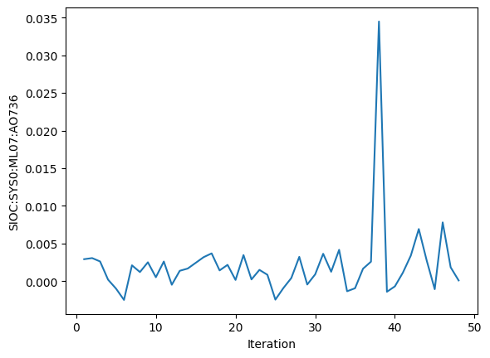
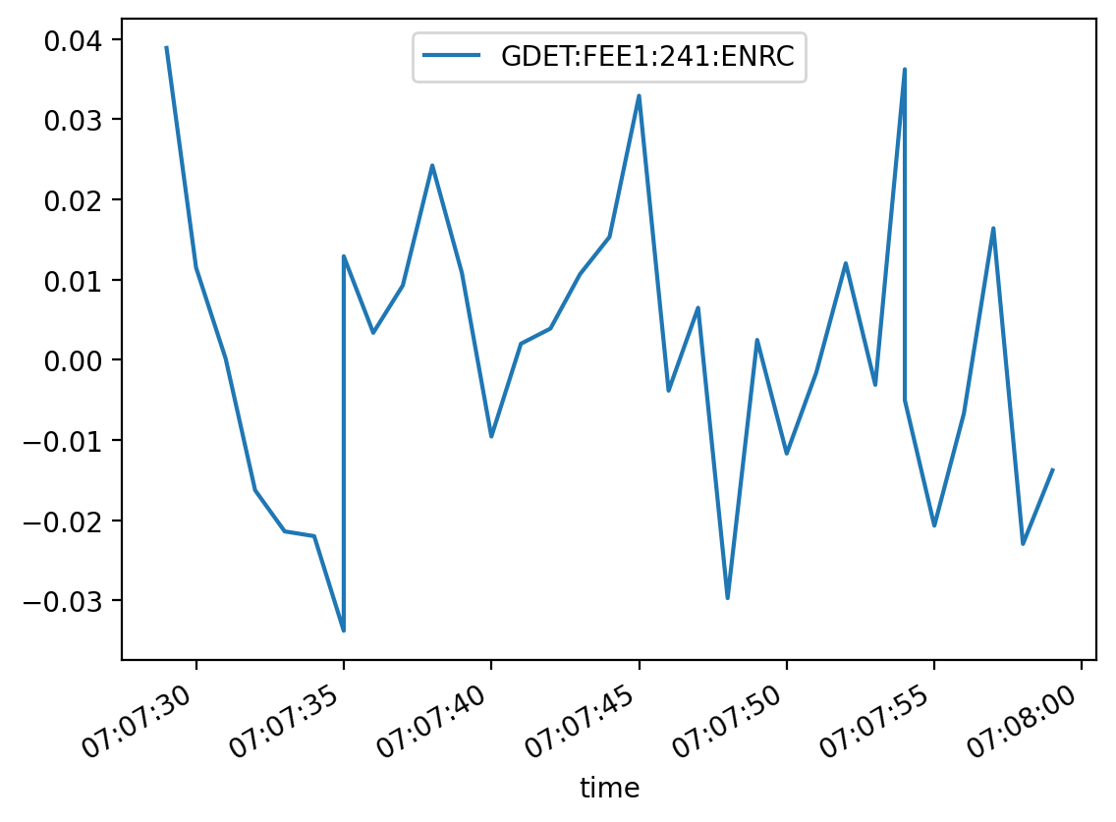
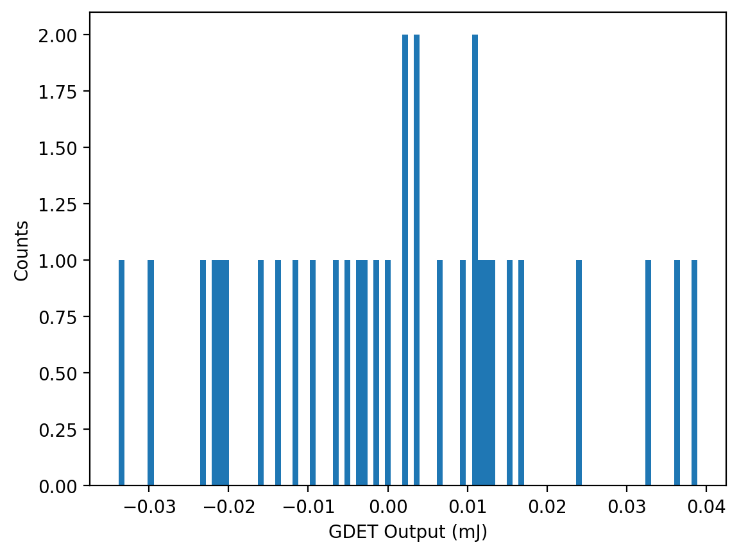
Details

Slide 7
Details
LCLS-Archive template
Range of dates and times
Folder of yaml files
List of PV names
Plotting settings for quads, MKBs, and TDLYs, for GDET info over time or iteration, plus histograms
Documents for important information for each yaml
Keys
Quads adjusted?
MKBs adjusted?
GDET PV present?
VOCs
Simple regression Gaussian process
Optimizing quads, MKBs, and TDLYs for obj_sum
Comparing predicted vs actual obj sum over time or iteration

Slide 8
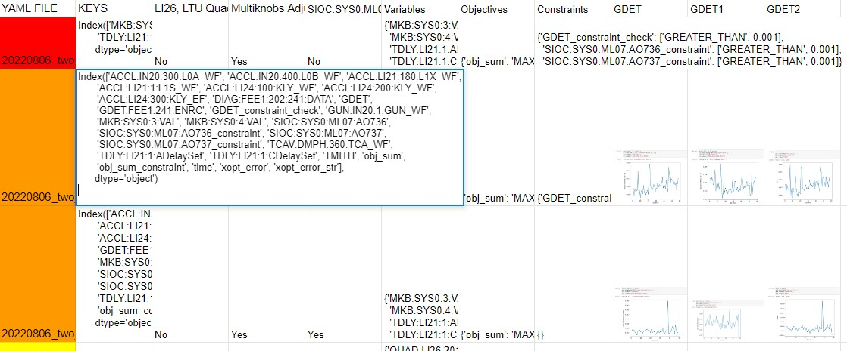
Details

Slide 9
Details
LCLS-Archive template
Range of dates and times
Folder of yaml files
List of PV names
Plotting settings for quads, MKBs, and TDLYs, for GDET info over time or iteration, plus histograms
Documents for important information for each yaml
Keys
Quads adjusted?
MKBs adjusted?
GDET PV present?
VOCs
Simple regression Gaussian process
Optimizing quads, MKBs, and TDLYs for obj_sum
Comparing predicted vs actual obj sum over time or iteration

Slide 10
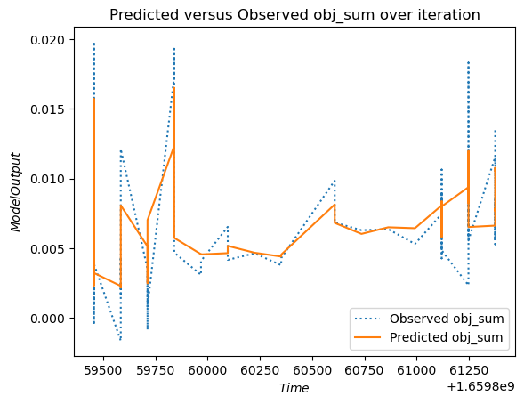
Details

Slide 11
Details
Numpy
Mamba
Jupyter
Jupyter_core
Jupyter_client
Jupyter-client
Jupyter-console
Jupyter-notebook
Jupyter-qtconsole
Jupyter-nbconvert
Jupyter-trust
Traitlets
Ipykernel
Packages
Xopt
Lcls_live.archiver
Json
Os
Yaml
Pandas
Matplotlib
Math
Torch
Botorch
Gpytorch
Tensorflow

Slide 12
Code Analysis
https://github.com/rsifuentes99/2bunchstudies/blob/main/raftask.ipynb
https://github.com/rsifuentes99/2bunchstudies/blob/main/raftask2.ipynb
https://github.com/rsifuentes99/2bunchstudies/blob/main/raftask3.ipynb

Slide 13
Results and Discussion
Task 1
Discontinuous changes
SLAC making changes to the settings / optimizing
Can analyze this area by just changing interval
“Optional” section of notebook doesn’t run
Data on time vs iteration
Iterations are not evenly spaced
Same plot for every yaml

Slide 14
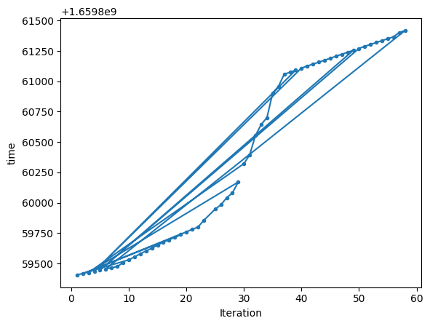
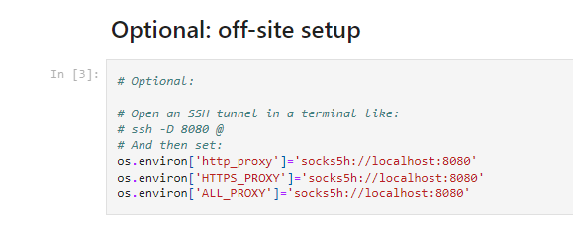
Results and Discussion

Slide 15
Results and Discussion
Task 2
Lack of uniformity
First, and last two were solo
Rest were in pairs
Shared keys, VOCs, quad adjustments, MKB adjustments, presence of GDET PVs, graphical similarities
PV name changes
Individual GDETs and also combined GDET (GDETC/obj_sum)
Only second and third files contained information using original names

Slide 16
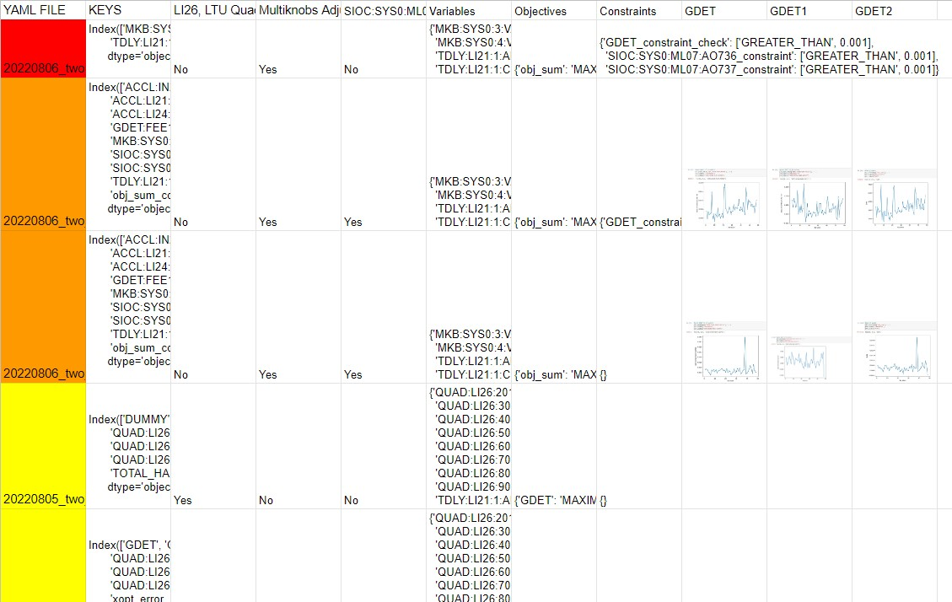
Results and Discussion

Slide 17
Results and Discussion
Task 3
Tutorial notebooks not fully compatible
Used generated data, not imported data
Contained single input and output vs n-dimensional input and single output
Ran quads, MKBs, and TDLYs as x-variables, obj_sum as y-variables
Suggestion on idea for improved code
Issues
Dimensionality
View data as slices or points
Memory
No found solution
Attempted uninstalling and reinstalling, conda, pip, local vs SDF, dll
Couldn’t graph predicted obj_sum vs actual obj_sum over time or iteration
Provided code
Length parameters
Inputs vary at different amounts
Used dynamic length scales
Pulled the predicted obj_sum towards the data points as expected

Slide 18
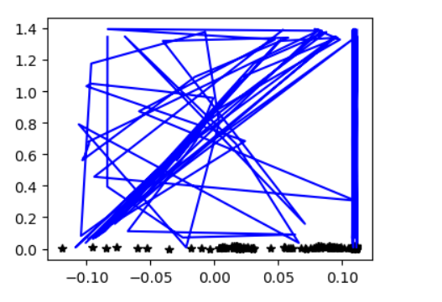
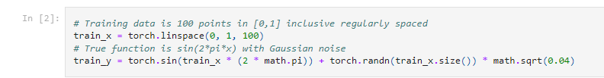
Results and Discussion

Slide 19
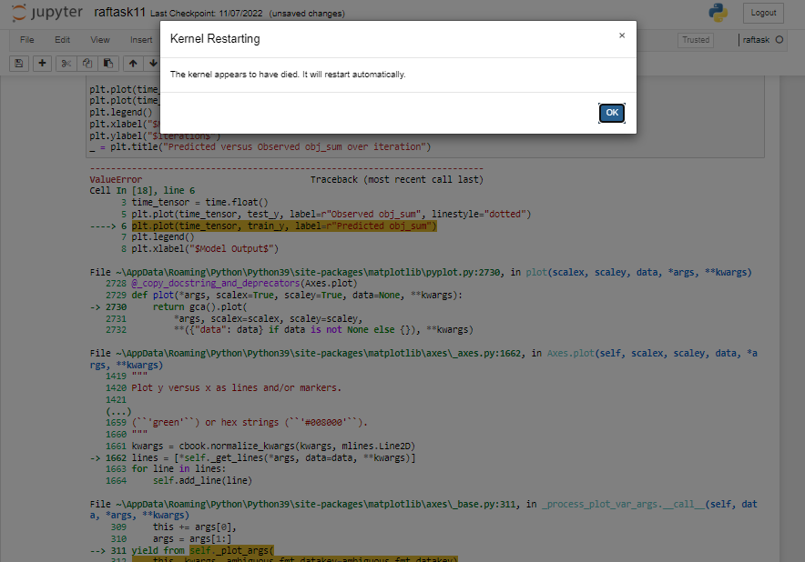
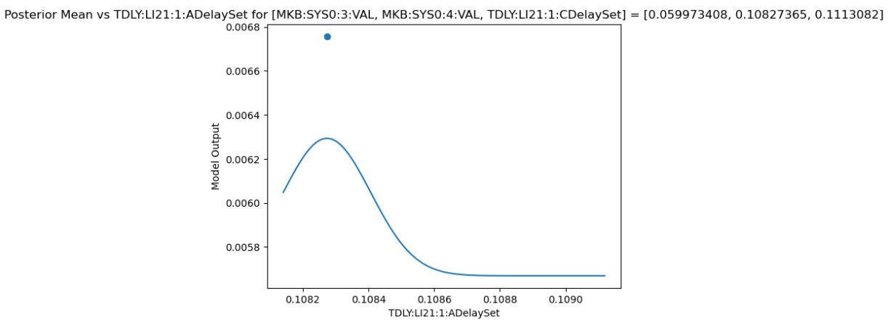
Results and Discussion

Slide 20
Conclusion
Primary tasks
Plot PVs from each yaml file relative to time and iteration, plus histograms
Create documents to record and plot interesting properties
Run simple Gaussian process on the data
Required several tutorials and example notebooks
Quite a bit of time to learn necessary tools and SLAC’s systems
Issues dealt with in each task
Iteration vs time
Yaml file uniformity
Dimensionality and memory
Data points pull obj_sum as expected

Slide 21
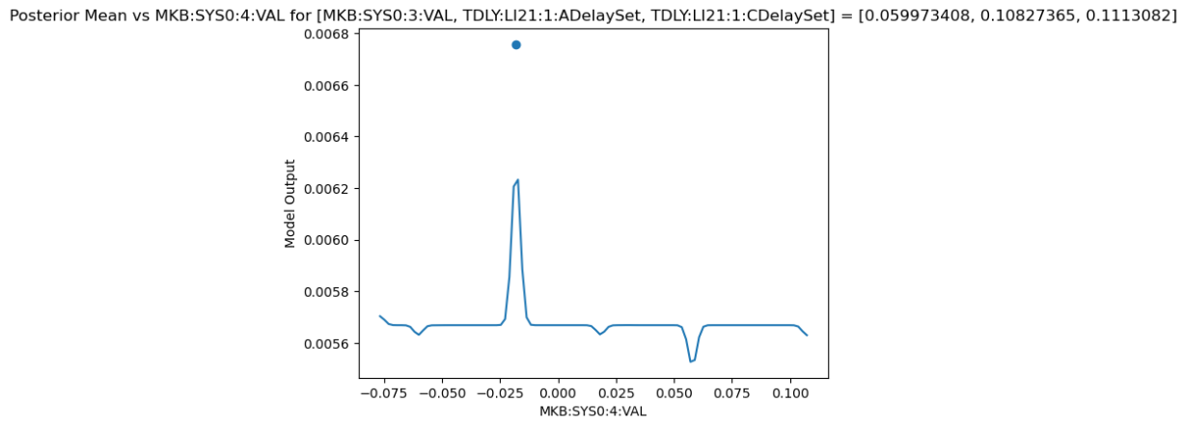
Conclusion

Slide 22
Recommendation
Difficult to get materials
Many things require SLAC email and SSH keys
Can’t access tutorials or resources like SDF or instructional pages
Can change unthreatening pages to not require identification
Create internship-specific instructions or tutorials
SLAC tasks, directories, environments, packages, GitHub, unix, etc.
GitHub with environments and kernels
Xopt was good start but contained incompatibilities that I couldn’t fix without help
Similar issues with Ubuntu, PyCharm, JupyterLab/ notebook
Specified time every week for 1-on-1 meetings
Tasks took minutes instead of hours
Some issues would be avoided earlier or entirely

Slide 23
Acknowledgement
Special thanks to:
Zhirong Huang
Auralee Edelen
Christopher Mayes
Alex Halavanau
Ryan Roussel
Yee Ting-Li
Michael Kelsey
Lance Nakata
Dylan Kennedy, Matt Gibbs
William Colocho

